Slide 1
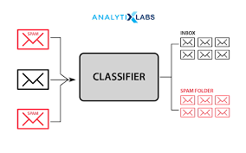
Classification Foundations
Predicting Categories and Making Decisions
Instructor: Zaryab Ahmad Khan

Slide 2
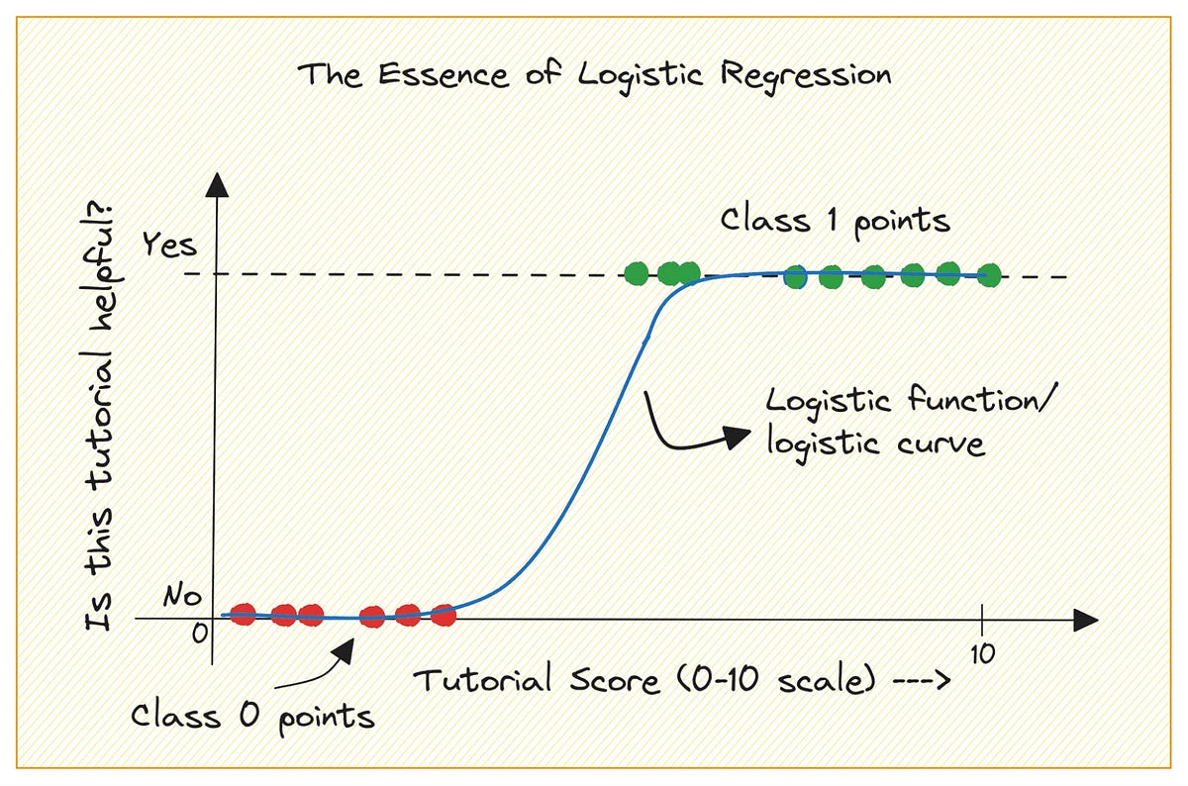
Logistic Regression (The S-Curve)
The Concept: Despite having "Regression" in its name, this is purely for classification. It predicts probabilities between 0 and 1.
How it works: It maps any real number to a value between 0 and 1 using a Sigmoid (S-shaped) curve. If the probability is $> 0.5$, it predicts "Yes" (1). Otherwise, "No" (0).
Real-World Use:
Is this patient at risk for a specific disease? (Yes/No)
Is this transaction fraudulent? (Yes/No)

Slide 3
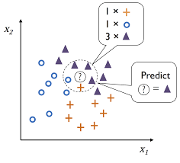
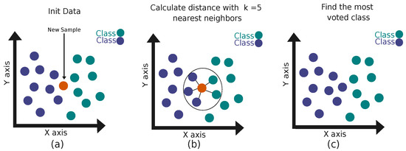
K-Nearest Neighbors (The Democratic Algorithm)
The Concept: "Tell me who your friends are, and I will tell you who you are."
How it works: When given a new data point, the algorithm looks at the K number of data points closest to it on the graph. It takes a "vote" among those neighbors to decide the category.
Important: Always use an odd number for K (like 3, 5, or 7) to avoid tie votes!

Slide 4
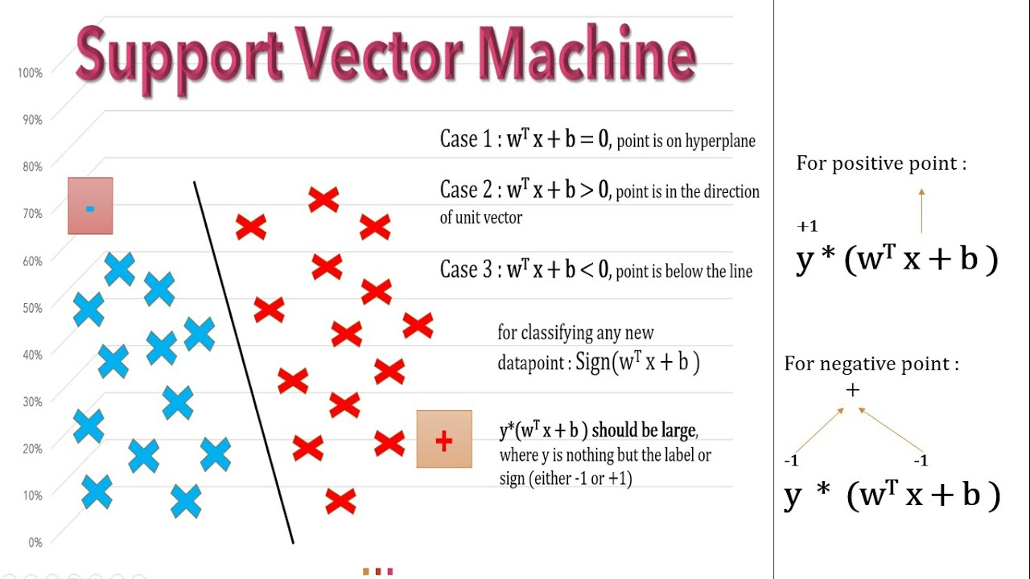
Support Vector Machines (The Widest Street)
The Concept: Drawing a boundary between categories.
How it works: SVM doesn't just draw a line between two classes; it tries to draw the widest possible mathematical street (margin) between them. The data points sitting right on the edge of the street are called the "Support Vectors".
Real-World Use: Highly effective in complex, high-dimensional spaces like image recognition or text categorization.

